Slide 1
Large language models: The GPT architecture

Slide 2

Steps in making a LLM
01
02
03
Language processing
Defining a models architecture
Model training and evaluation

Slide 3


01
Language processing

Slide 4
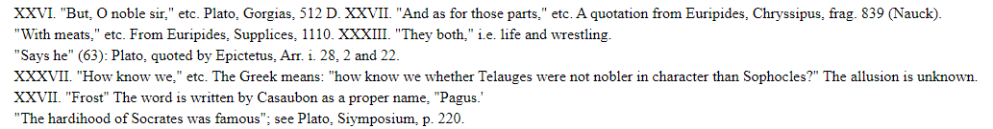
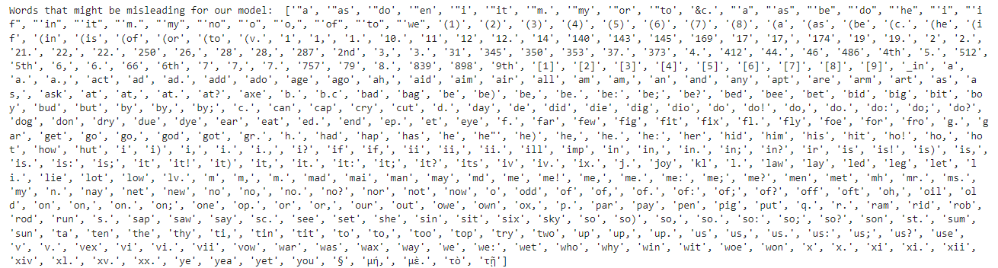
Text cleanup

Slide 5

Tokens?

Slide 6
Tokens?
Words:

Slide 7
Tokens?
Words:
Letters:

Slide 8
Tokens?
Words:
Letters:
Subwords:

Slide 9
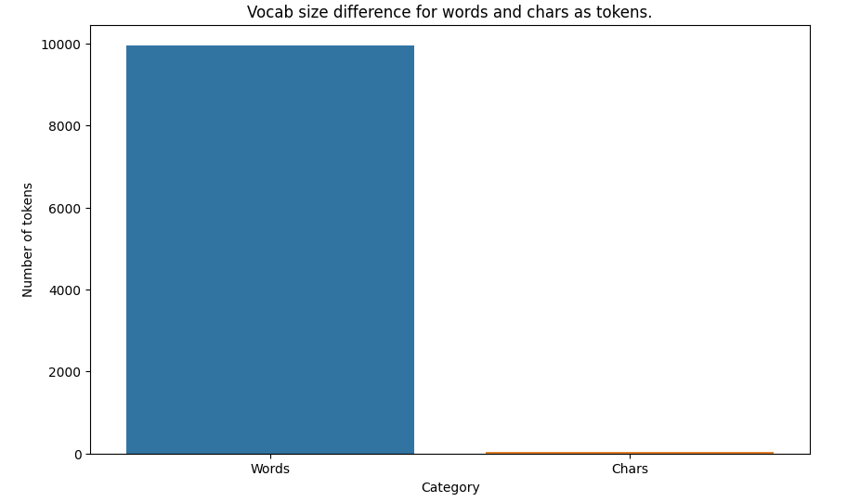
Tokens?

Slide 10

Encoding

Slide 11
Encoding
0
1
2
3
4
5
6
7
8
9
10
11
12
13
14
15
16
17
18

Slide 12
Decoding
0
1
2
3
4
5
6
7
8
9
10
11
12
13
14
15
16
17
18

Slide 13


Training and validation sets

Slide 14
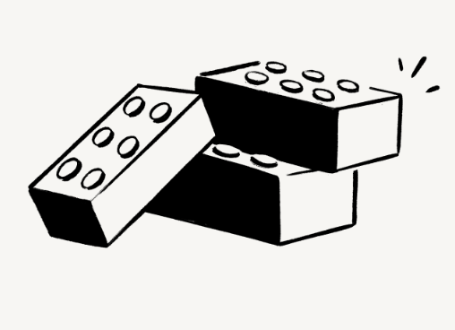
“Block”

Slide 15
“Block”
“Block” of size 8 tokens

Slide 16
“Block”
“Block” of size 8 tokens

Slide 17
“Block”
“Block” of size 8 tokens

Slide 18
“Block”
“Block” of size 8 tokens

Slide 19
“Block”
“Block” of size 8 tokens

Slide 20
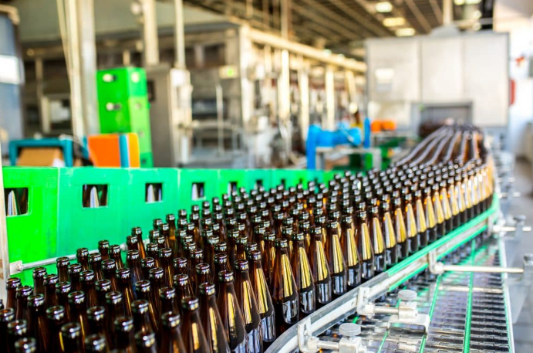
“Batch”
“Batch” of size 4 “Blocks”

Slide 21
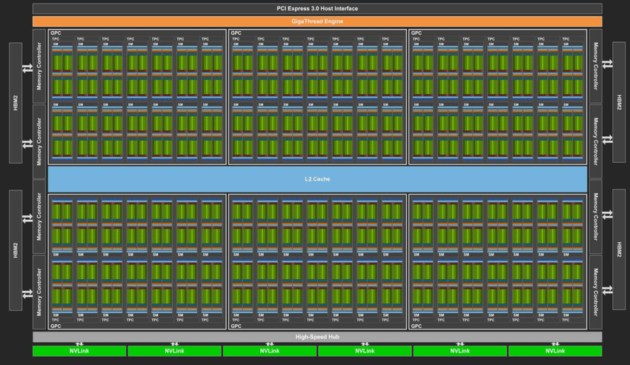

Slide 22
03
Model training and evaluation

Slide 23
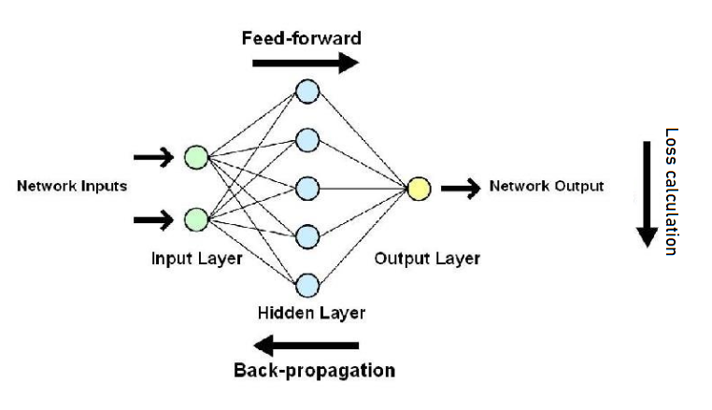
Deep neural network

Slide 24
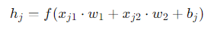
Deep neural network

Slide 25
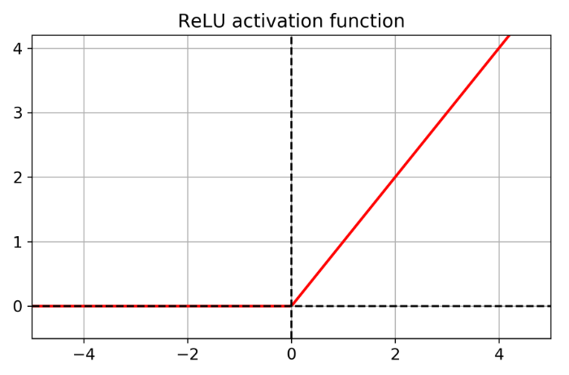
Deep neural network

Slide 26
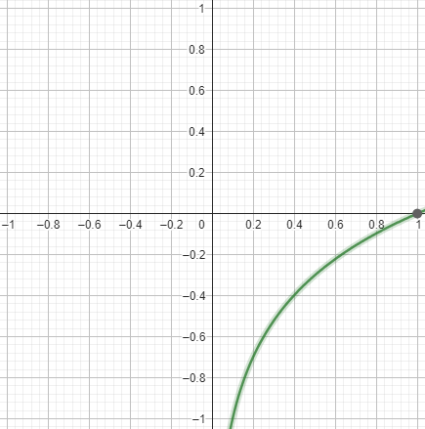
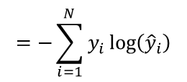
Loss calculation
$$=−\sum_{i=1}^{N}{y_{i}\log\left({\hat{y}}_{i}\right)}$$
Cross entropy

Slide 27
Back propagation

Slide 28
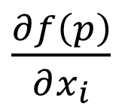
Back propagation
$\frac{∂f\left(p\right)}{∂x_{i}}$

Slide 29
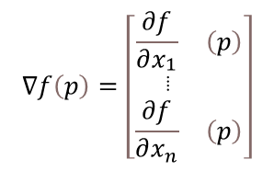
Back propagation
$$∇f\left(p\right)=\left[\begin{matrix}\frac{∂f}{∂x_{\begin{aligned}&1 \\ &⦙\end{aligned}}} & \left(p\right) \\ \frac{∂f}{∂x_{n}} & \left(p\right)\end{matrix}\right]$$

Slide 30
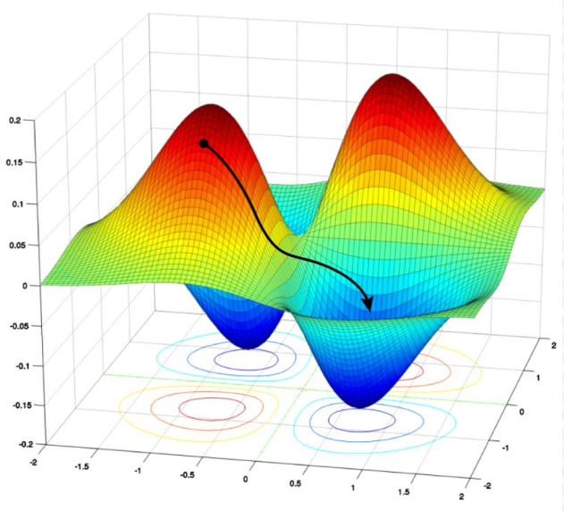
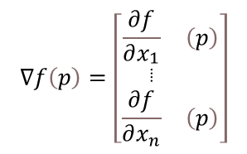
Back propagation
$$∇f\left(p\right)=\left[\begin{matrix}\frac{∂f}{∂x_{\begin{aligned}&1 \\ &⦙\end{aligned}}} & \left(p\right) \\ \frac{∂f}{∂x_{n}} & \left(p\right)\end{matrix}\right]$$

Slide 31
02
Defining a models architecture

Slide 32
Bigram model

Slide 33
Bigram model

Slide 34
Bigram model

Slide 35
Bigram model

Slide 36
Bigram model

Slide 37
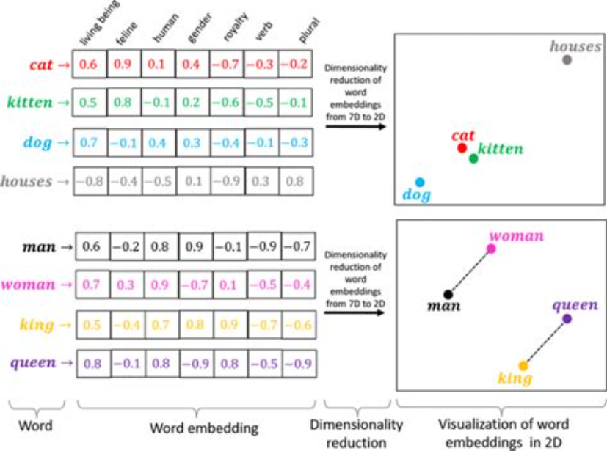
Bigram model

Slide 38
GPT model

Slide 39

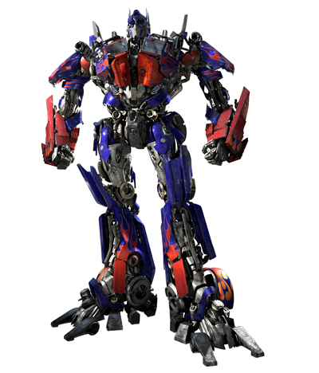
GPT model

Slide 40
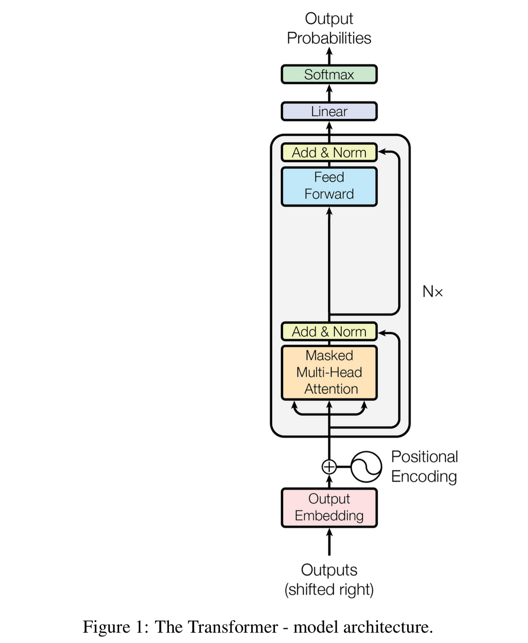
GPT model

Slide 41
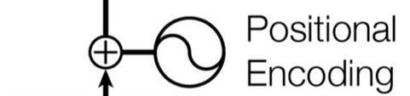
GPT model

Slide 42
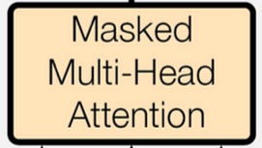
GPT model

Slide 43
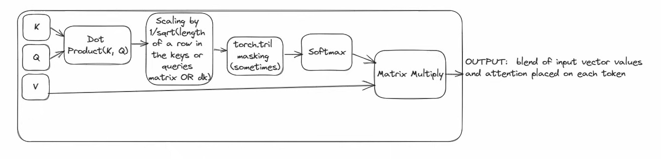
GPT model

Slide 44
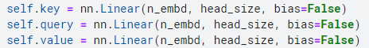
GPT model

Slide 45
GPT model

Slide 46
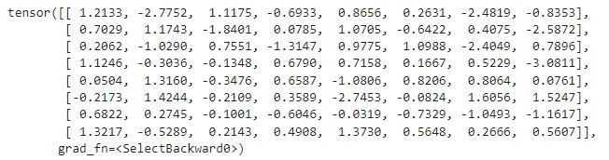
GPT model

Slide 47
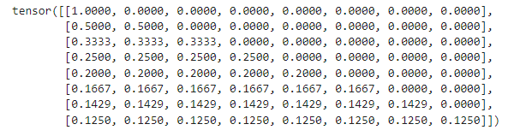
GPT model

Slide 48
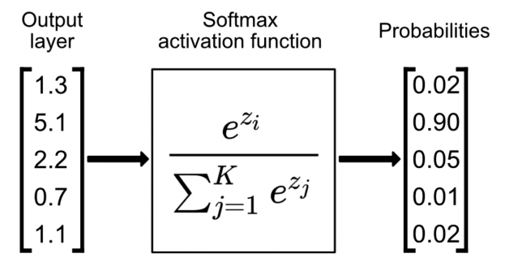
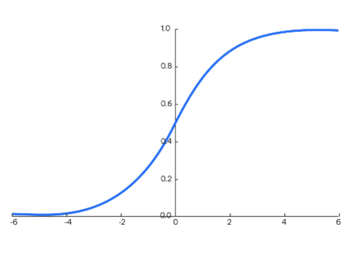
GPT model

Slide 49
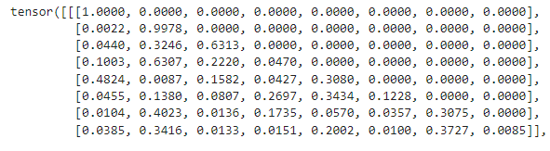
GPT model

Slide 50
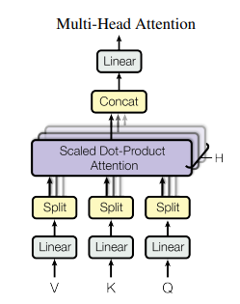
GPT model

Slide 51
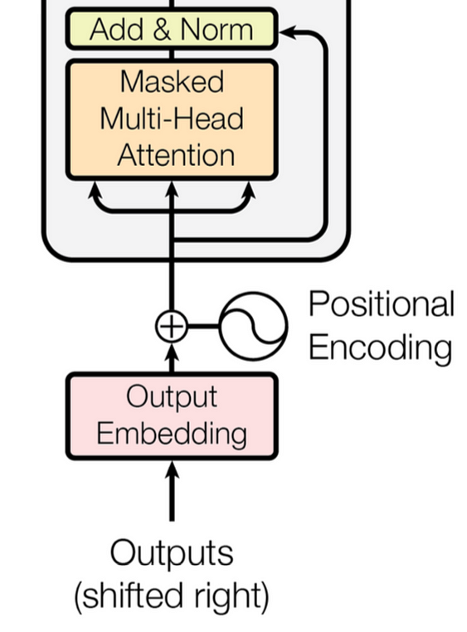
GPT model

Slide 52
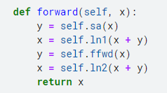
GPT model

Slide 53
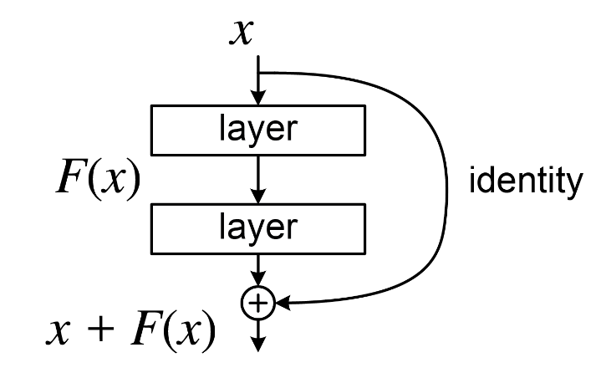
GPT model

Slide 54
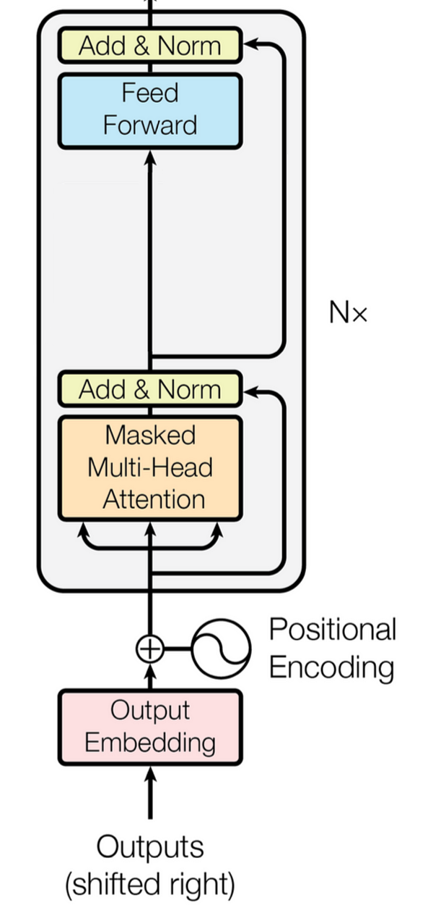
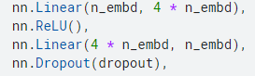
GPT model

Slide 55
GPT model

Slide 56
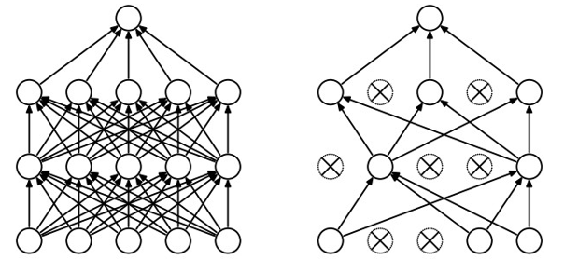
GPT model

Slide 57
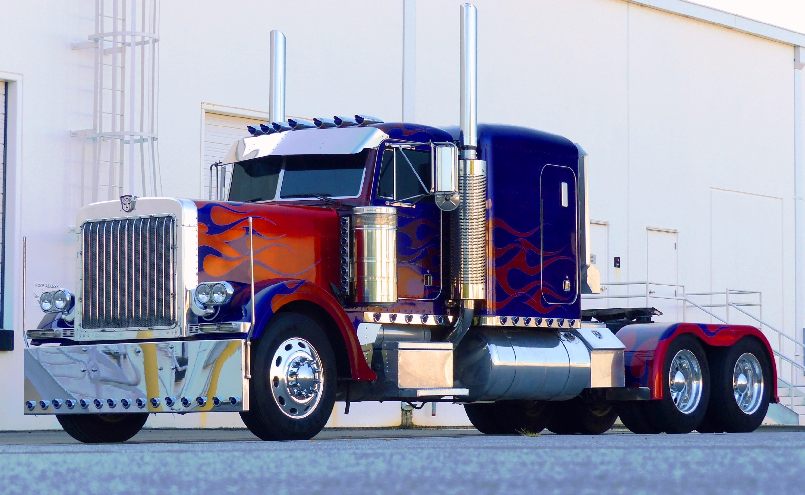
GPT model

Slide 58
Model evaluation

Slide 59
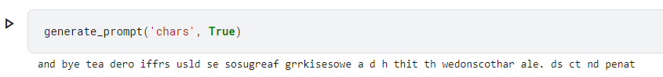
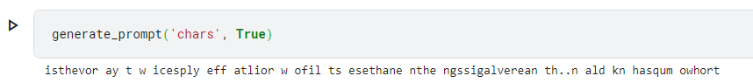
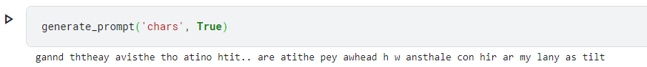
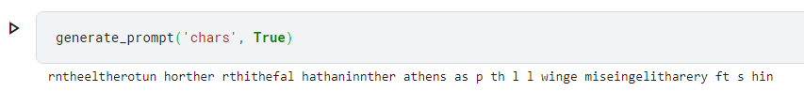
Bigram model with char tokens
1

Slide 60
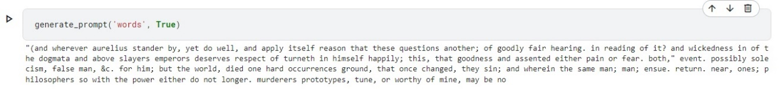
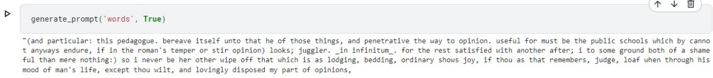
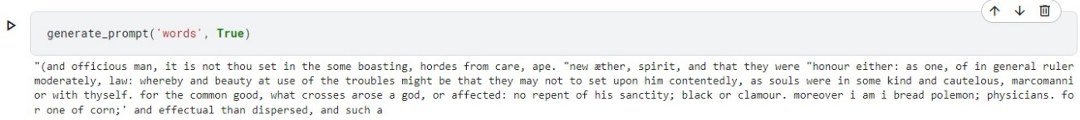
Bigram model with word tokens
1
2

Slide 61
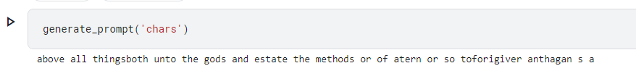
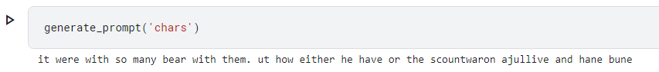
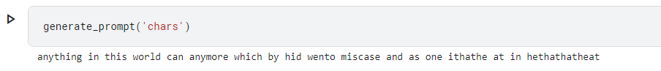
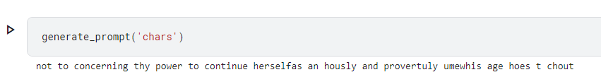
GPT model with char tokens
1

Slide 62
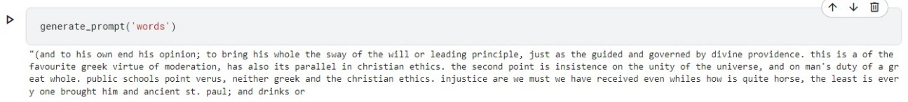
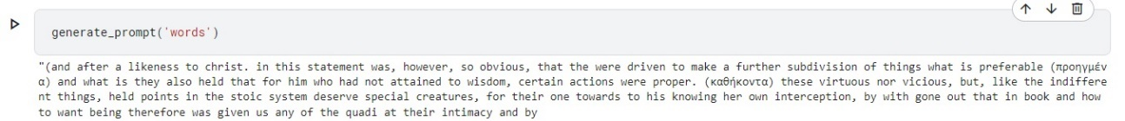
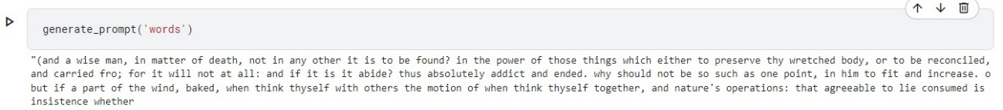
GPT model with word tokens
1
2

Slide 63
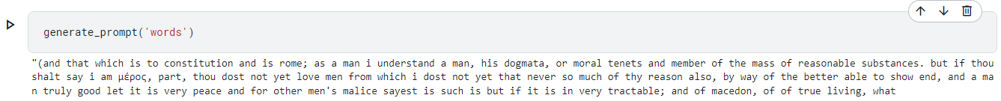

GPT model with word tokens
1
2

Slide 64
Thank you for listening!
Mihajlo Madžarević

